Slide 1


2019
Department
Of Computer
Science
&
Electrical And
Electronics
Engineering
MATH-IV
KAS -402
2020-2021
Dr.Rupa Sharma
Associate Professor
vsrsrsys@gmail.com
Notes:
Thisv is Cover page

Slide 2
Topic -8 [Find the particular integral]

Slide 3
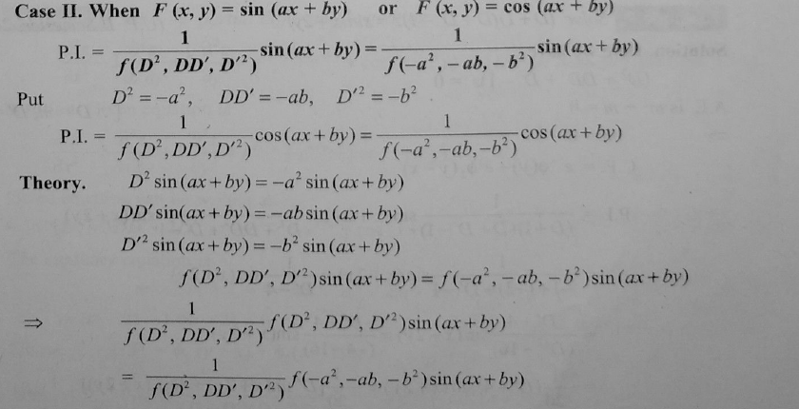


Slide 4
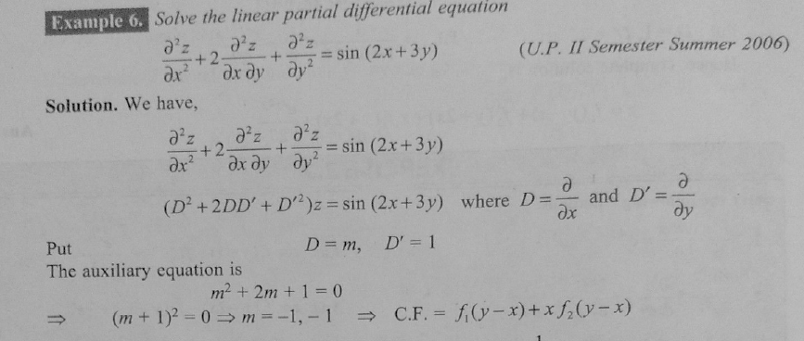

Slide 5
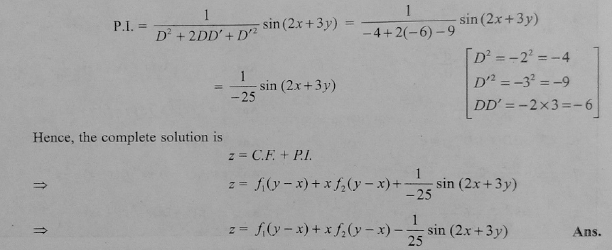

Slide 6
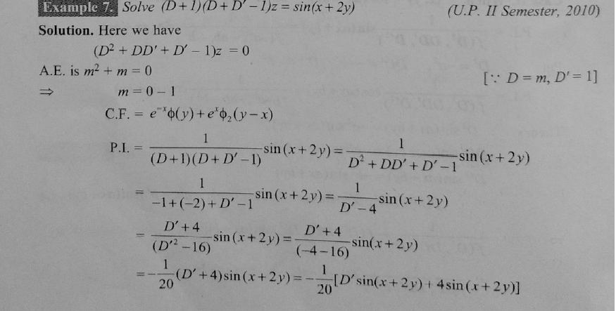

Slide 7
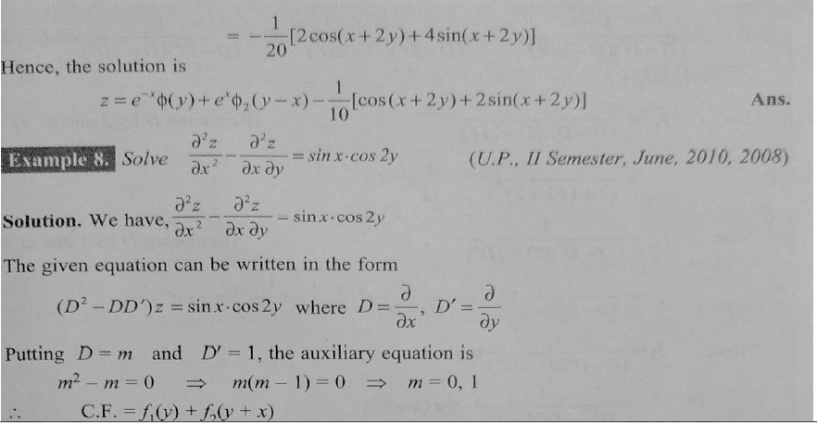

Slide 8
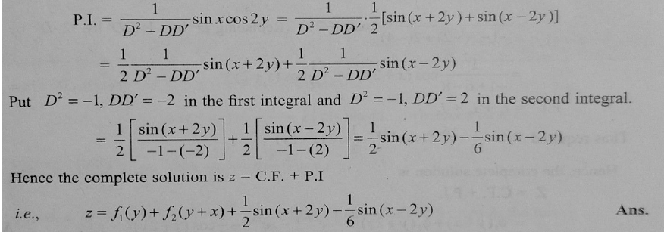

Slide 9


HOME WORK
ANS

Slide 10
THANK YOU

